Slide 1


Rabiammal Ahamed Maideen College For Women, Thiruvarur

Slide 2
India’s Agricultural Crop Production Analysis (1997-2021)
By
P.Lakshmi priya
M.Nanthineeswari
S.Nithiya Sri
T Ponnieswari
File created on 13.10.2023

Slide 3
INTRODUCTION
Our project title is India’s Agricultural Crop Production Analysis(1997-2021).
The collection of agricultural land crop productions between the years 1997 to 2021.

Slide 4
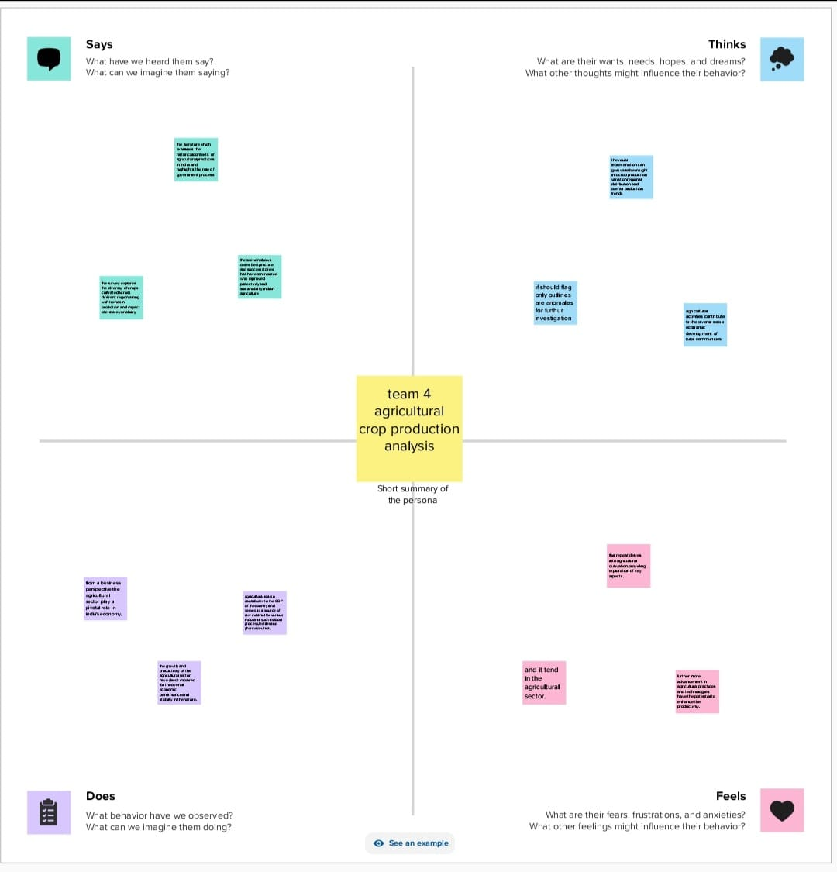
PROBLEM DEFINITION AND DESIGN THINKING
Empathy map:

Slide 5
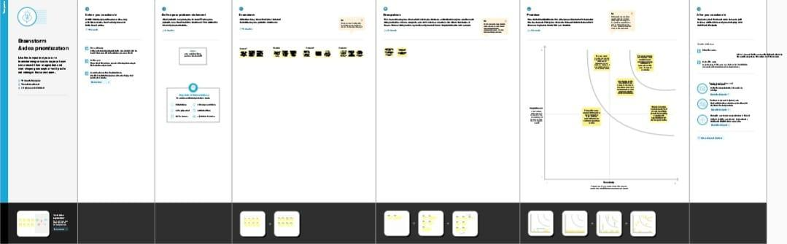
BRAIN STORMING:

Slide 6
RESULT:
Finally finding output of the project along with the screenshot

Slide 7
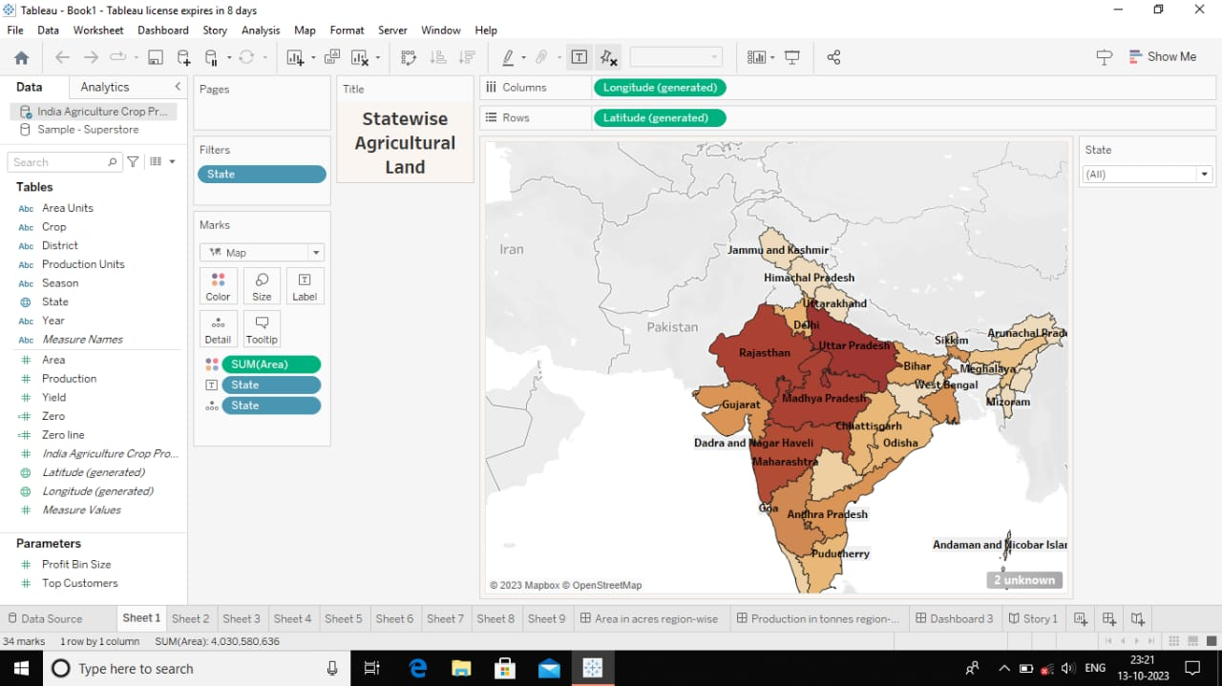
SHEET 1:
This picture shows the statewise agricultural production in India

Slide 8
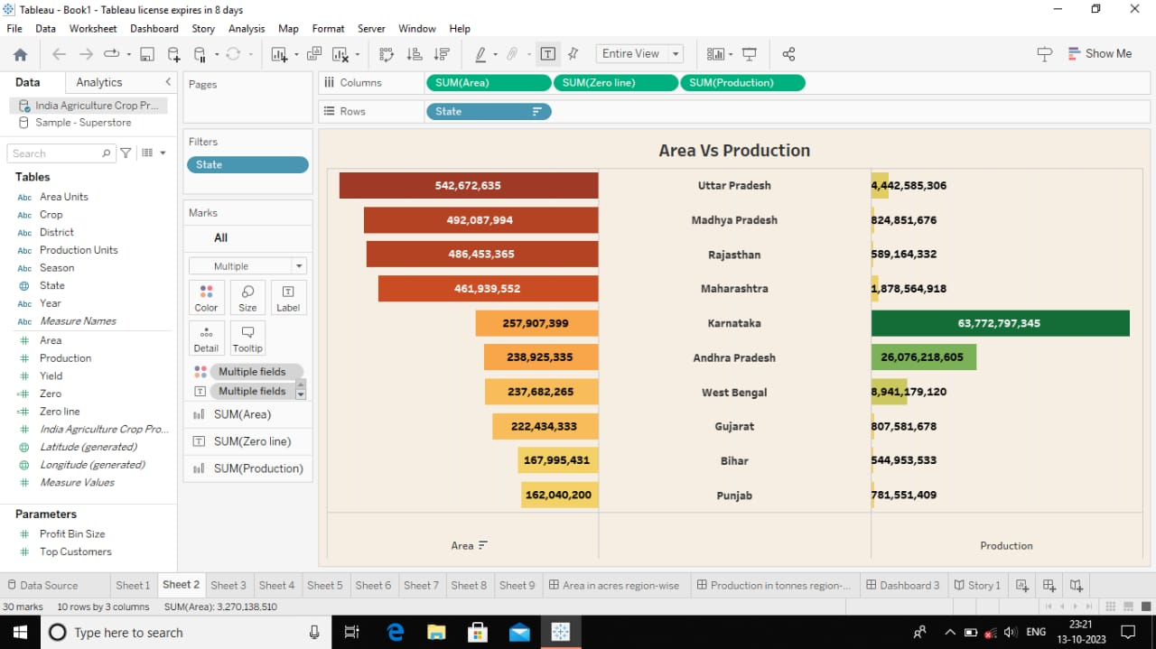
SHEET 2:
It shows the area and production of the crops in India from this we found that Uttar Pradesh has large area and Karnataka has high production.

Slide 9
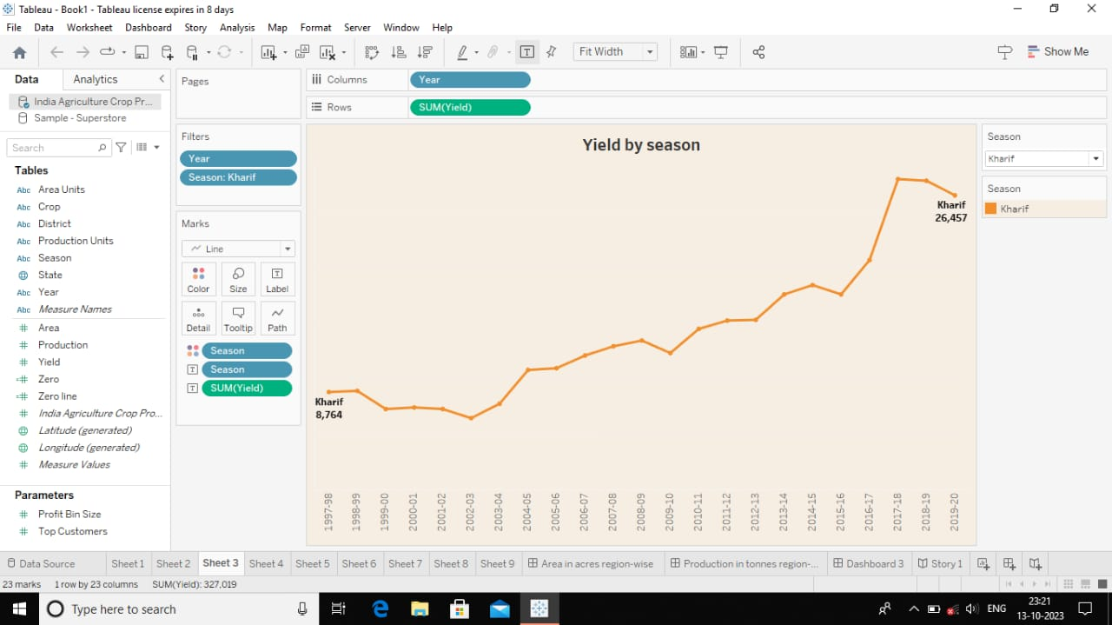
SHEET 3:
This slide shows the season yields more crops in India

Slide 10
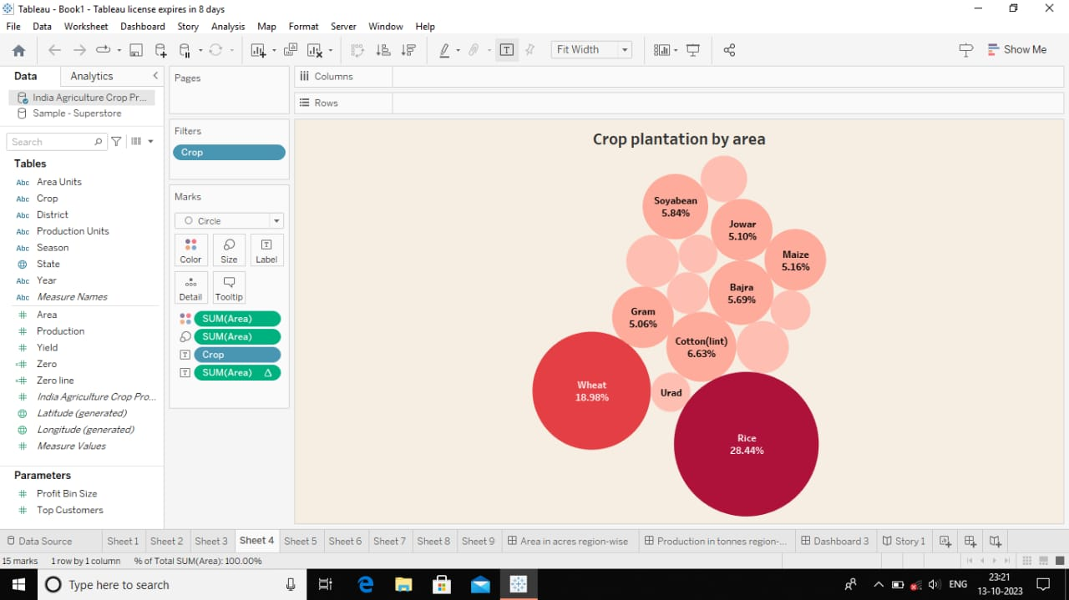
SHEET 4:
It shows the crop plantation by area.

Slide 11
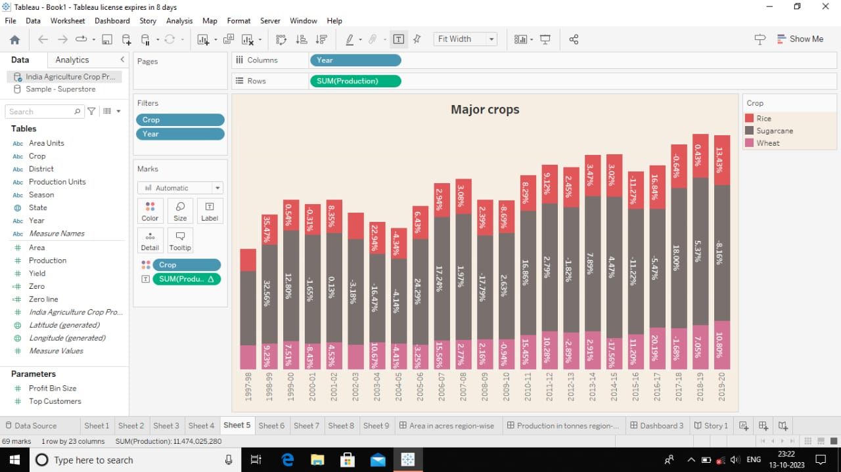
SHEET 5:
It shows the majority of the crops that are cultivated in India along with the percentage.

Slide 12
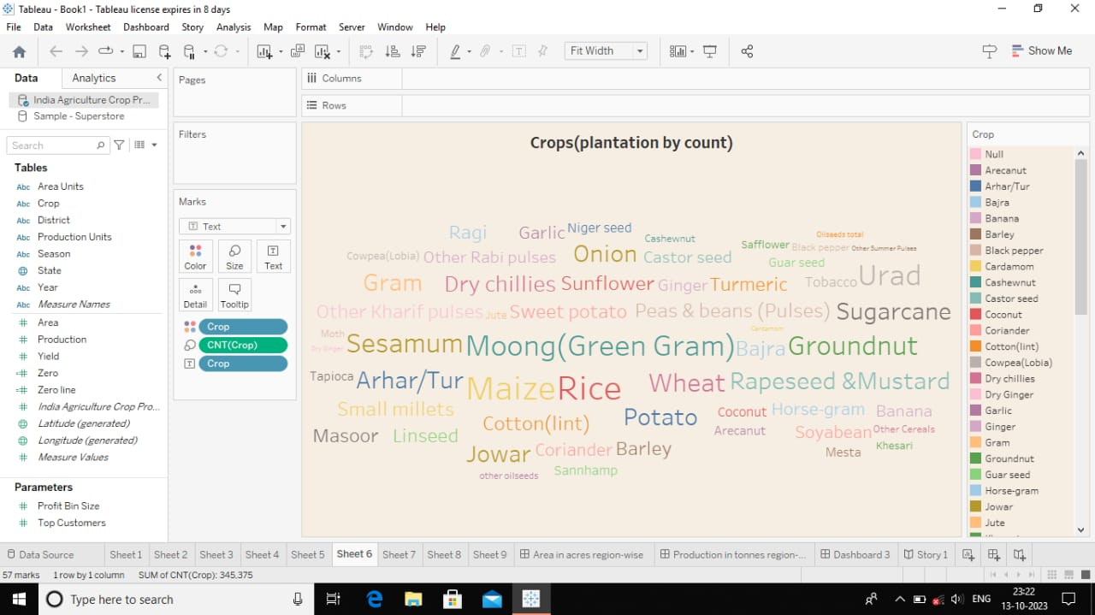
SHEET 6:
This slide shows the crops that are plantation by its count.

Slide 13
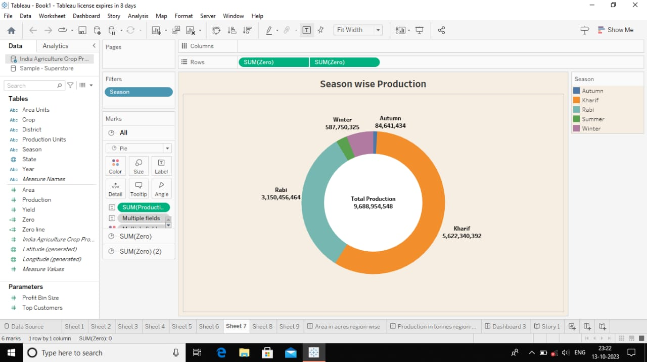
SHEET 7:
It shows the season wise production in India from this we found the Kharif is the largest production compare to other seasons.

Slide 14
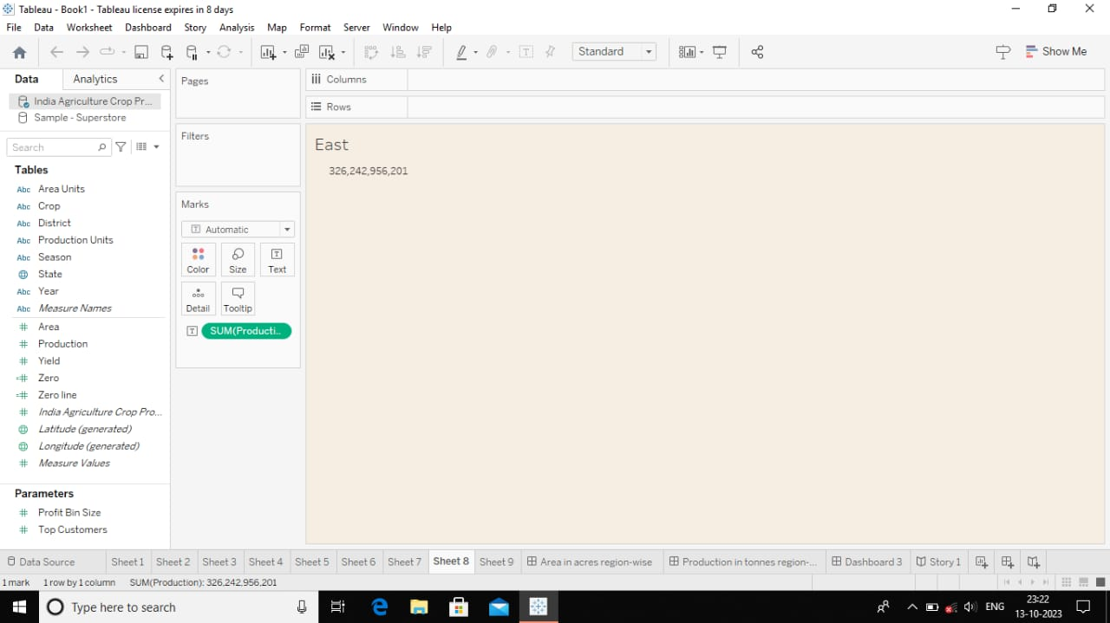

Slide 15
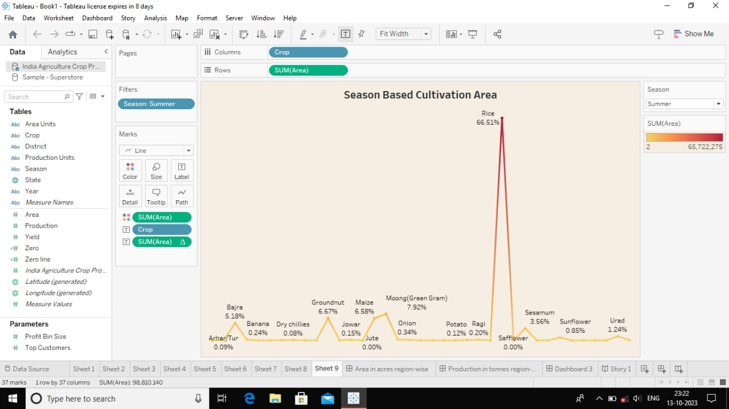
SHEET 9:
It shows the season based cultivation area. Here rice is the largest cultivation compare to other areas.

Slide 16
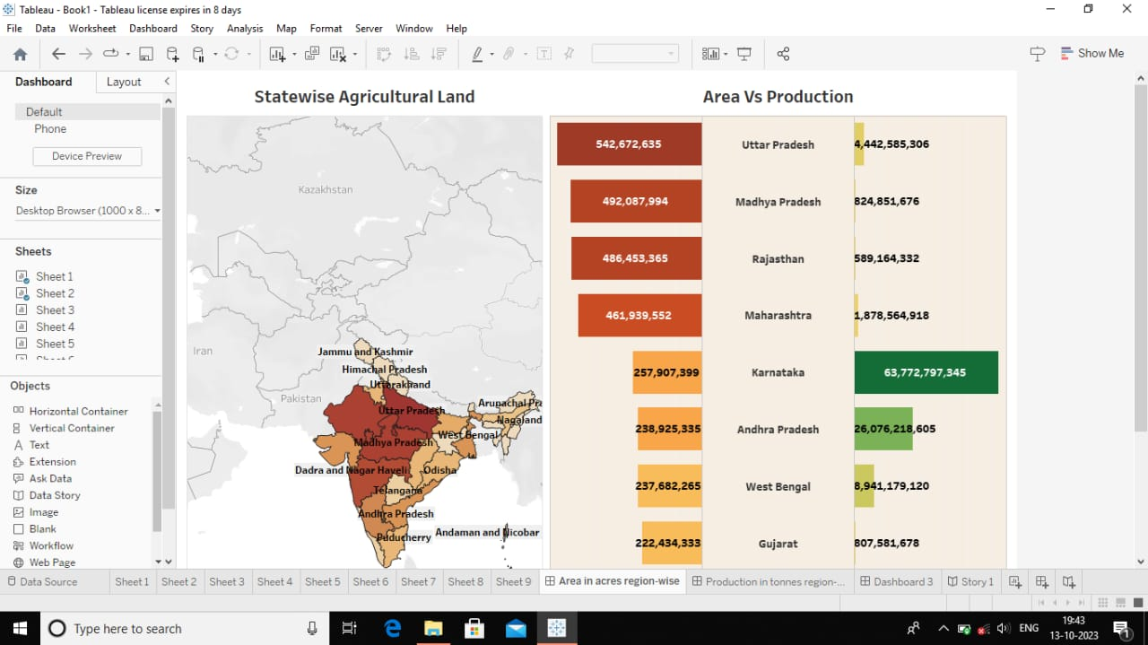
DASHBOARD 1:

Slide 17
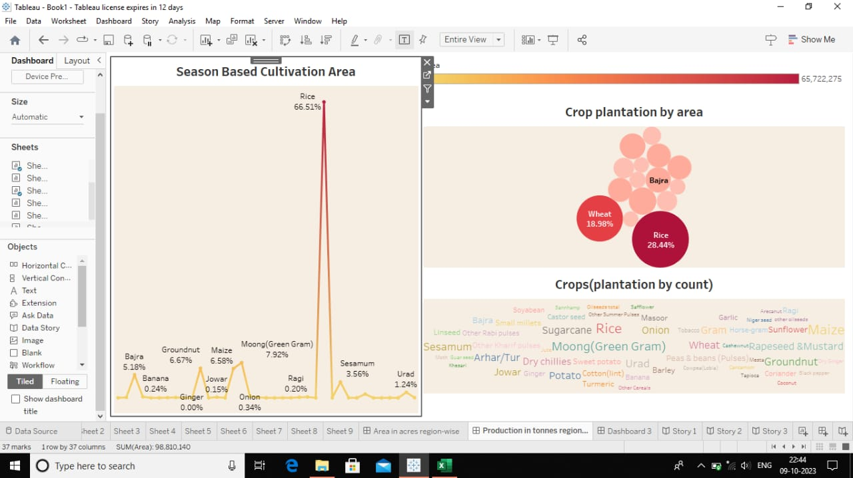
DASHBOARD 2:

Slide 18
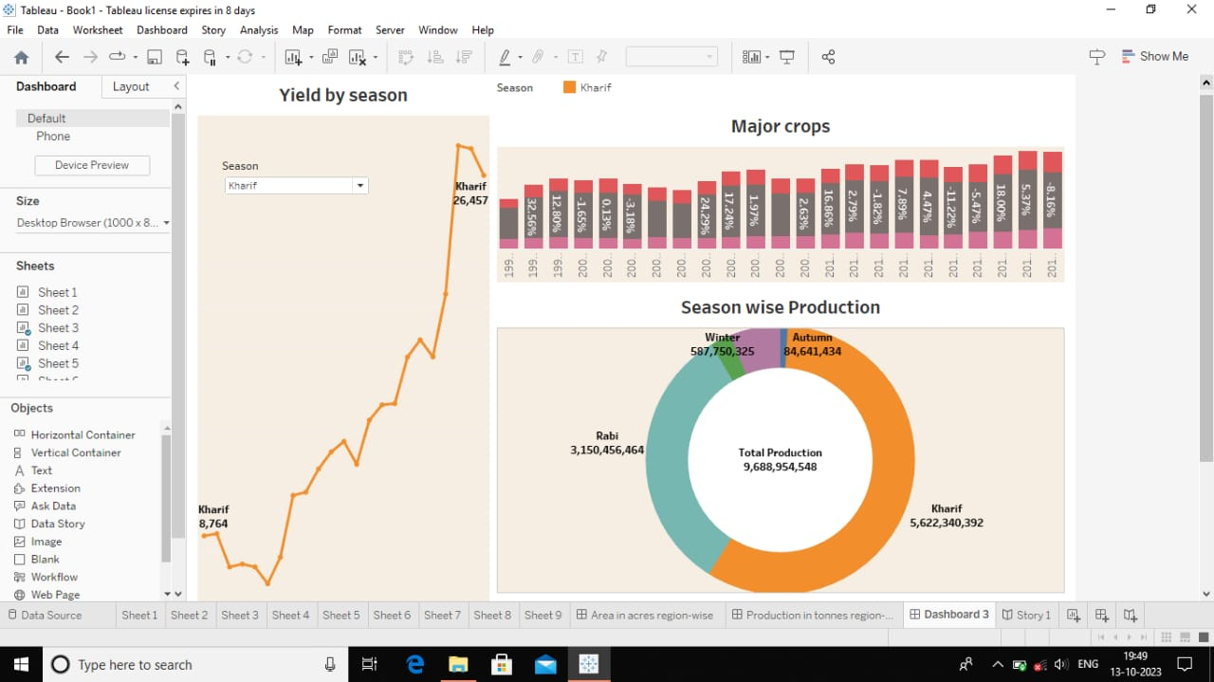
DASHBOARD 3:

Slide 19
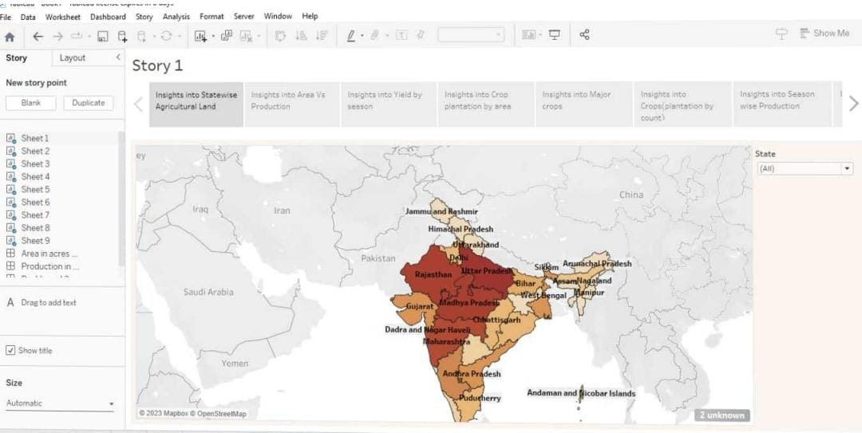
STORIES:

Slide 20
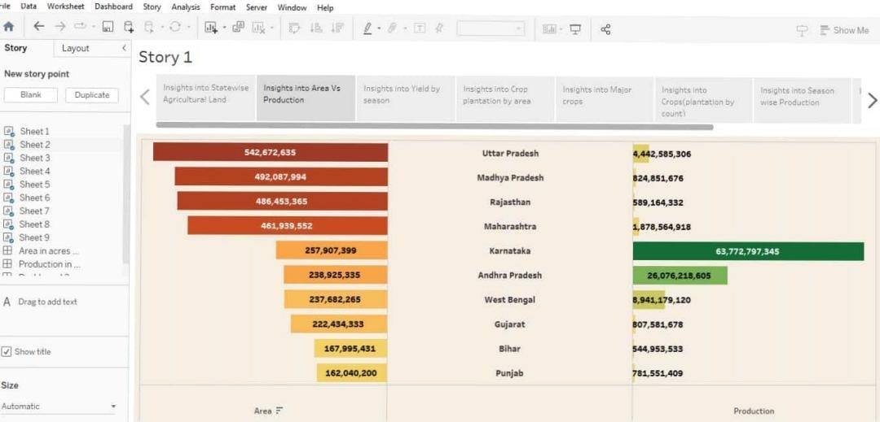

Slide 21
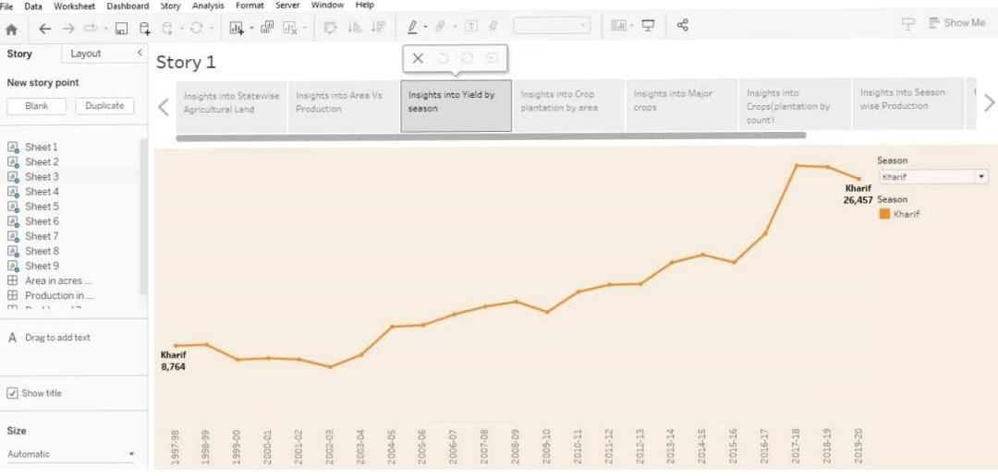

Slide 22
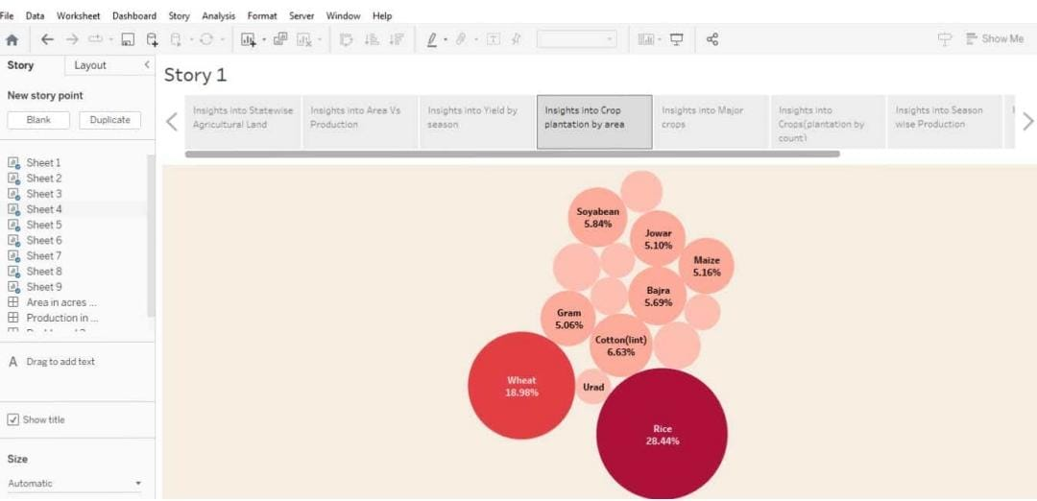

Slide 23
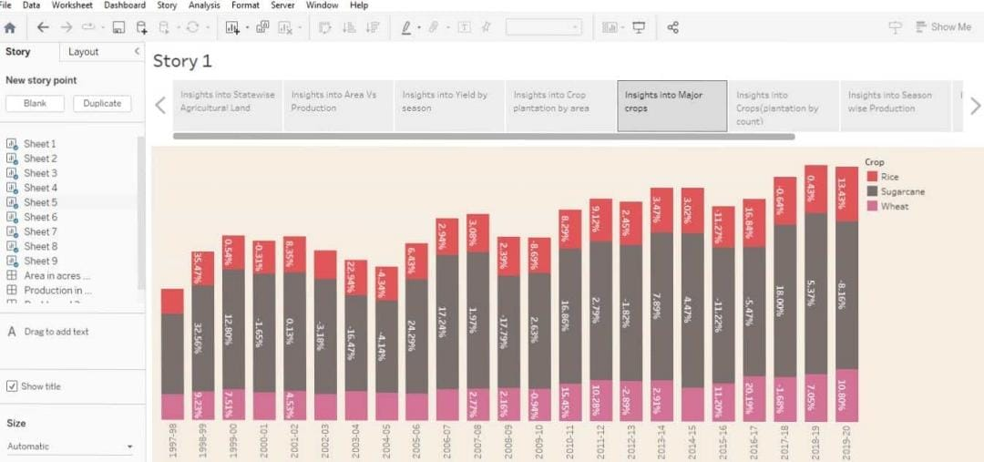

Slide 24
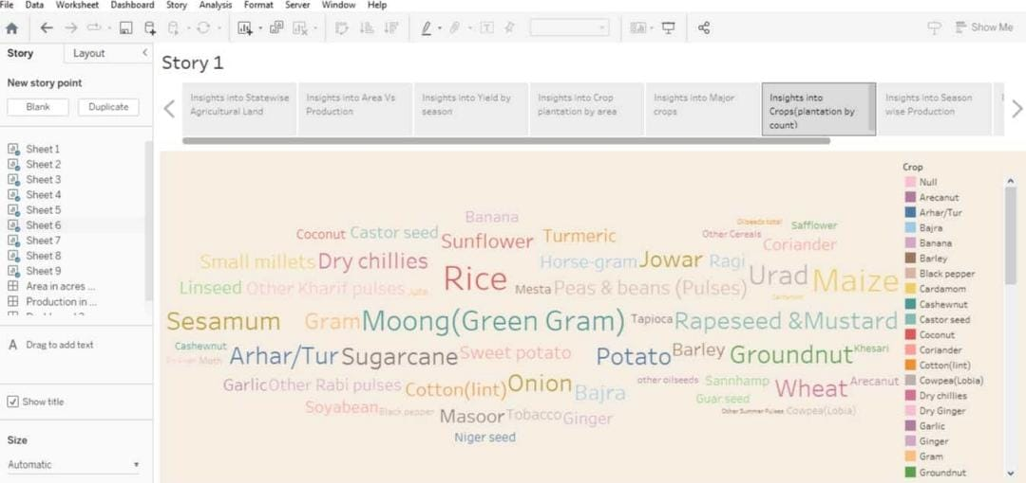

Slide 25
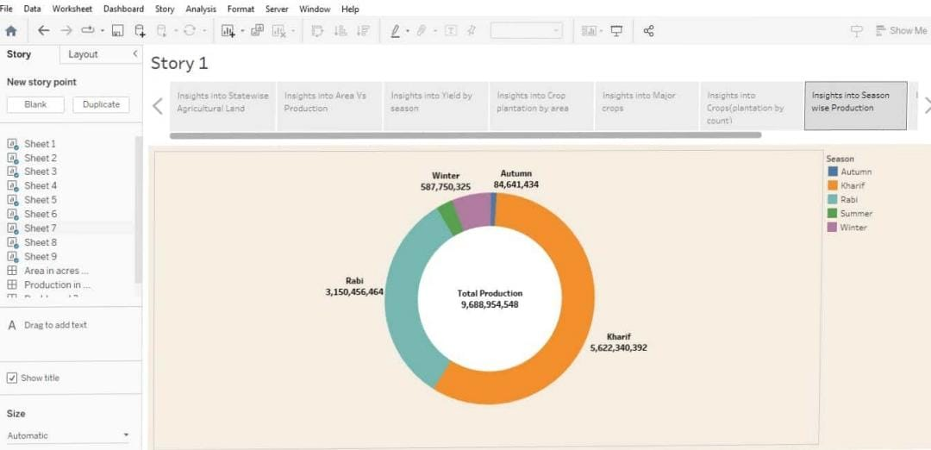

Slide 26
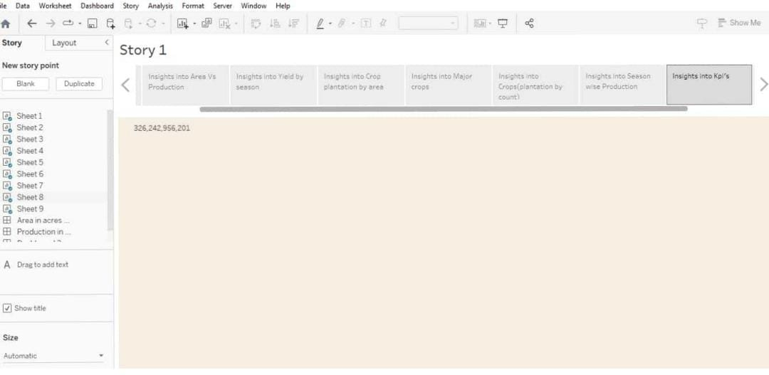

Slide 27
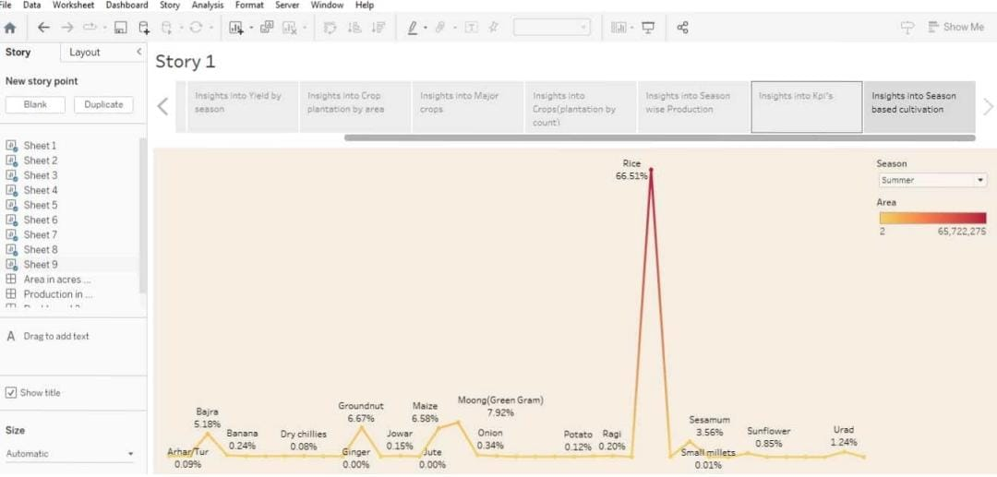

Slide 28
CONCLUSION:
While there is a huge potential of analysis, let us summarize what we analyzed.

